Slide 1


PROJECT ON
TOUR PACKAGE ANALYSIS

Slide 2

- I am Maneesh Kumar , a recent graduate with a degree in “Master of Computer Applications” from KV Subba Reddy Institute Of Technology at Kurnool.
Why Data Analyst ?
"I'm passionate about working with data because I enjoy problem-solving and finding patterns. My interest in analysis and uncovering insights inspired me to build a career in Data Analyst.“
LinkedIn : https://www.linkedin.com/in/maneesh-kumar-somireddypalli/
GitHub : https://github.com/Maneesh-1121

Slide 3
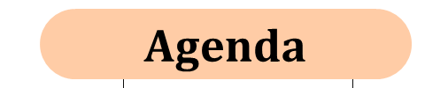
Problem Statement
Objectives of the Project
Web Scraping Details
Summary of the Dataset
Data Cleaning Steps
Univariate & Bivariate Analysis
Business Questions and Insights
Conclusion
Recommended
Challenges Faced
Q&A

Slide 4

Travelers often struggle to compare and select the best travel packages due to scattered information across multiple platforms. The dataset contains detailed attributes of 970 travel packages, including destination, duration (days/nights), price range, average price, discounts, hotel star ratings, and inclusions. The challenge is to analyze this data to:
Understand pricing patterns and affordability.
Compare destinations based on budget, stay duration, and inclusions.
Identify the best-value packages by balancing cost, discount, and quality (hotel stars).
Provide insights to travel agencies for designing attractive packages.

Slide 5

Customer Decision Support
Help travelers choose the best package based on budget, discount offers, hotel ratings, or number of days.
Market Insights for Agencies
Identify trends like popular destinations, average pricing ranges, and demand for certain package types.
Pricing & Discount Analysis
Understand the pricing strategies (min, max, average) and evaluate how discounts affect affordability.
Quality & Value Evaluation
Correlate hotel star ratings, price, and included services to assess value-for-money.
Trend Identification
Spot seasonal or location-specific patterns (e.g., higher prices for Maldives vs. domestic locations).
Package Optimization
Suggest ideal price ranges, hotel categories, and inclusions to attract customers.

Slide 6
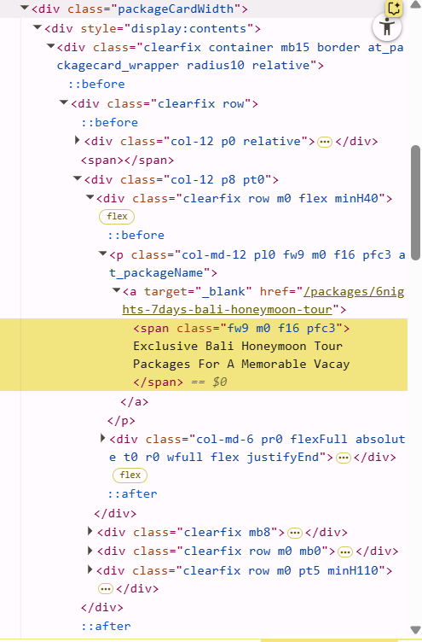
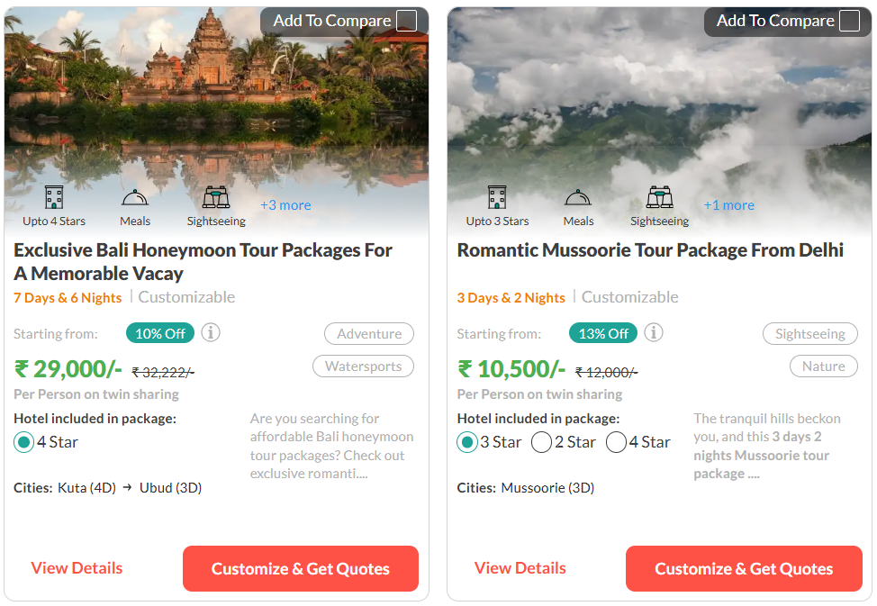
WEB SCRAPING DETAILS
Website Scraped : traveltriangle.com.
Tools Used : Selenium, Pandas, Regular
Expressions.
Steps Followed :
Navigated paginated pages.
Extracted details : Title, Location,
Duration, Price, Discount, Inclusions etc..
Stored in Data Frame and exported to CSV
Total Packages Scraped : 970

Slide 7

The dataset contains information about 970 travel tour packages, each represented by 9 columns. The columns and their contents are as follows:
Columns Overview :
Title: Name or description of the tour package.
Location: City or cities included in the package, often with the number of days in each.
Days: Total duration (in days) of the package.
Nights: Total duration (in nights) of the package.
Price_Min: Minimum price for the package.
Price_Max: Maximum price for the package.
Avg_Max : Average Price for the package.
Discount: The percentage discount offered on the package.
Hotel_Stars: Hotel star rating (e.g., 2 Star, 3 Star, 4 Star, 5 Star).
Included: Number of activities included, sometimes with a list or count.

Slide 8
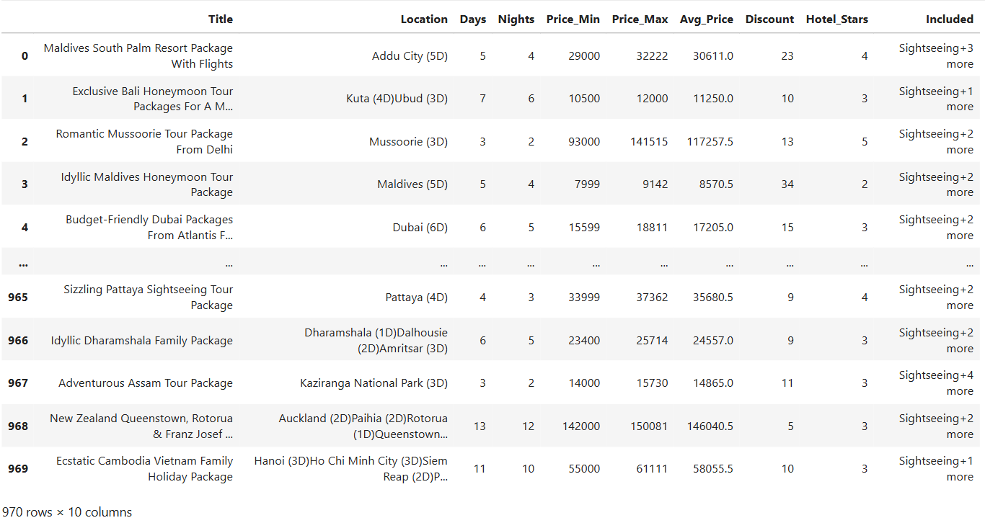
UNDERSTANDING THE DATA

Slide 9
DATA CLEANING STEPS
Extracted the columns .
Replaced the NULL_values with 2 in Hotel_Stars column..
Standardized numeric fields (Price, Days, Nights, Discount)
Converted Dtypes for smooth analysis.
Checked the Duplicates and removed if there are any found.
Detected Outliers.
Instead of removing extreme values, we limit (cap) them at a certain threshold so they don’t distort the analysis.
Removed extreme values after capping.
Prepared the Dataset for feature engineering and EDA.

Slide 10
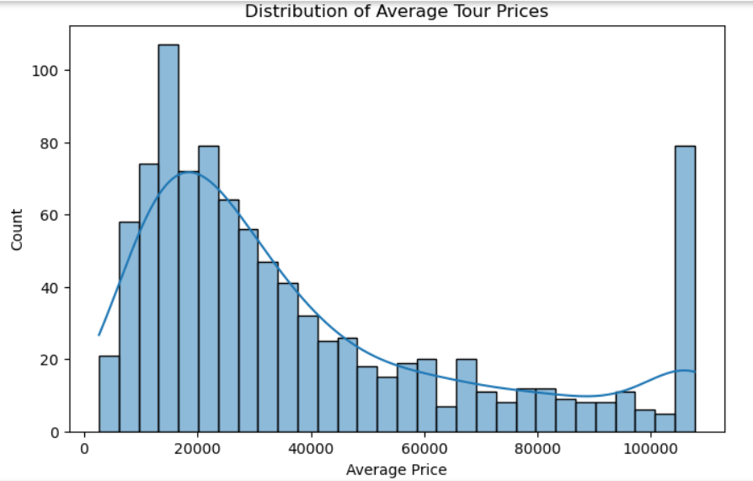
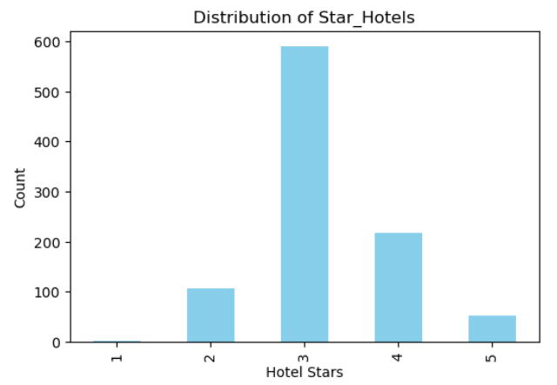
UNIVARIATE ANALYSIS
Distribution of Avg_Price :
This is best described as a right-skewed (positively skewed) distribution,not normal or symmetric.
Distribution of Hotel_Stars :
This indicates that 3-star hotels overwhelmingly dominate the sample, Suggesting a possible preference or greater availability for mid-range accommodation.

Slide 11
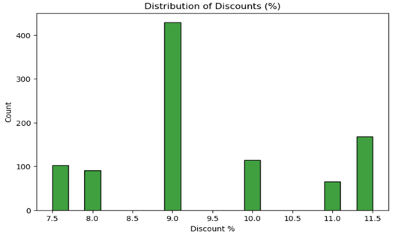
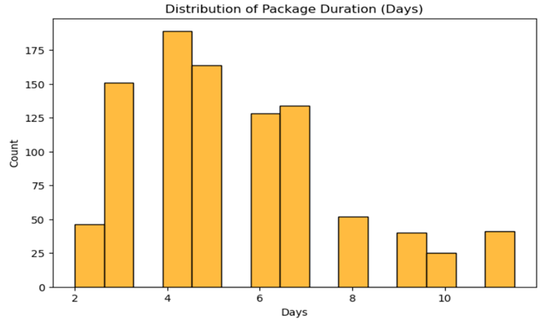
Distribution of Discount :
The discount rates are discrete, and the distribution is strongly skewed toward 9%, suggesting that most transactions or records apply this standard discount, while higher and lower rates appear less often.
Distribution of Days :
The distribution is right-skewed, with the majority of packages clustered around the 3-6 day range and a tail extending towards longer durations.There is a sharp drop in counts for durations beyond 6 days.

Slide 12
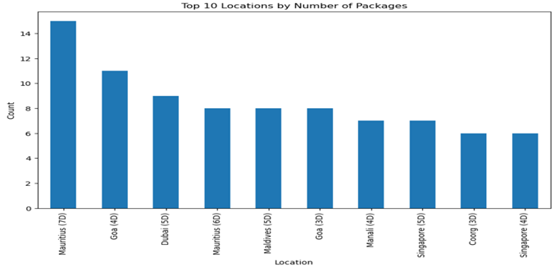
Bar chat of Top 10 Travel Locations :
This bar chart displays the top 10 travel locations ranked by the number of available packages, with each bar representing a specific destination and package duration combination.

Slide 13
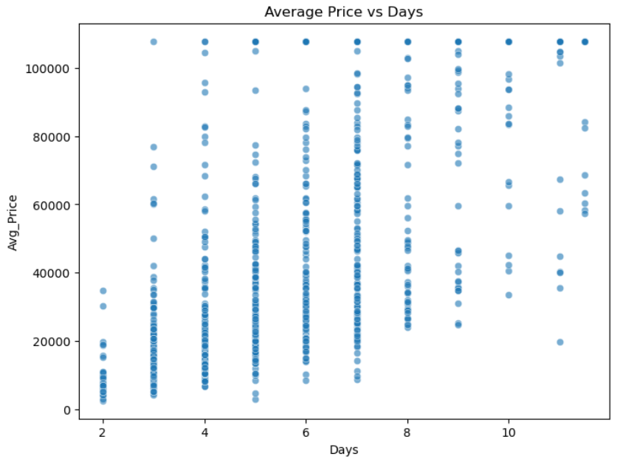
BIVARIATE ANALYSIS
Average price vs days :
This plot displays the relationship between average price ("Avg_Price") and days ("Days"). The scatter plot shows a wide vertical spread of price values for each day, indicating significant variability in average price across different days.

Slide 14
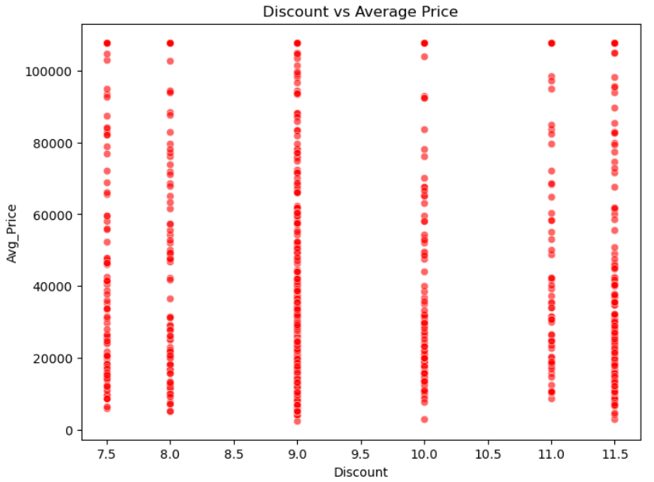
Discount vs Average_Price :
This plot shows the relationship between "Discount" and "Average Price" (Avg_Price) using a scatter plot. Each red dot represents a data point with a specific discount value on the x-axis and its corresponding average price on the y-axis.
The discount values are discrete and fall between approximately 7.5 and 11.5, forming vertical bands of points.
For each discount value, the average price varies widely, ranging from near zero up to over 100,000.

Slide 15
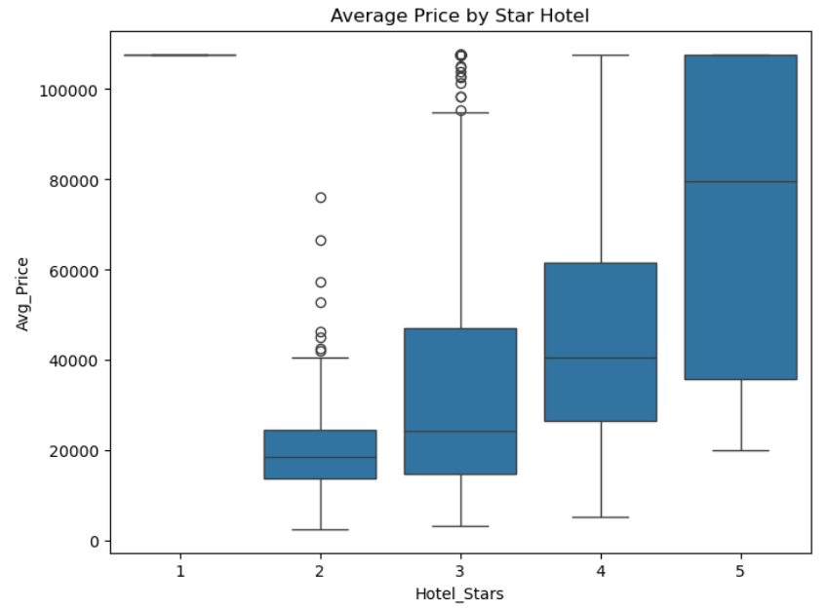
Average Price vs Star_Hotel :
This box plot visualizes the distribution of average hotel prices across different hotel star ratings. The x-axis represents hotel star ratings from 1 to 5, and the y-axis shows the average price.
As the number of hotel stars increases, the average price also rises, indicating a positive relationship between hotel quality (as measured by stars) and price.
The spread (interquartile range) and median price both increase with higher star ratings, especially from 2-star to 5-star hotels.
The 5-star hotels generally have the highest prices and the biggest spread in pricing.

Slide 16
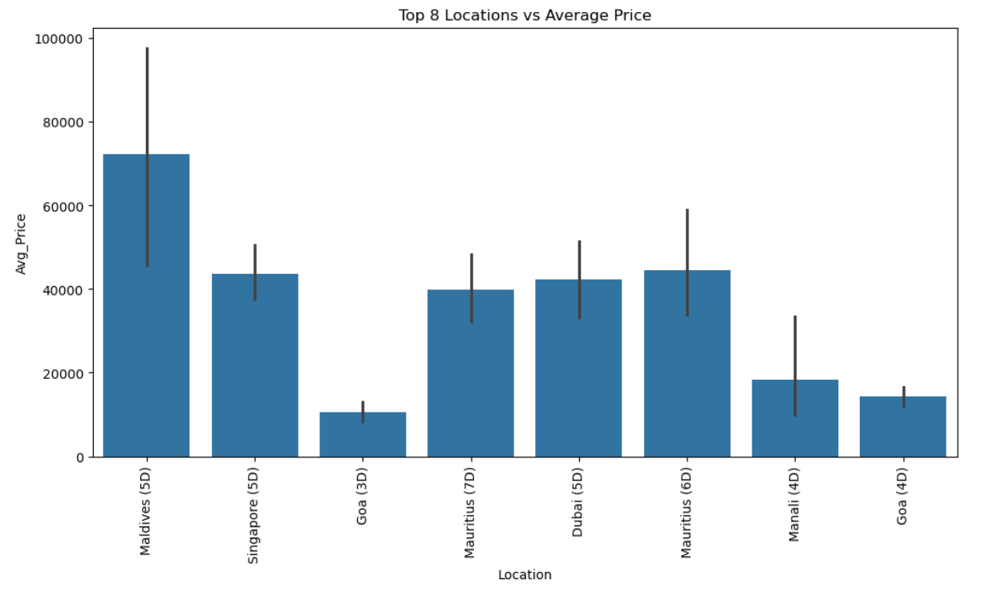
Top 8 Locations vs Average Price :
This bar chart displays the average prices for the top 8 travel locations, with each bar representing a specific location and its typical trip duration in days. The chart also includes error bars, indicating variability or uncertainty in the average price for each location.
Among top destinations, exotic or international locations (like Maldives and Singapore) are generally more expensive than domestic or shorter trips (like Goa and Manali).
For budget-sensitive travelers, Goa and Manali offer the least expensive average prices with relatively stable costs. In contrast, those seeking luxury or exclusive experiences should expect higher and more variable prices at destinations like the Maldives.

Slide 17
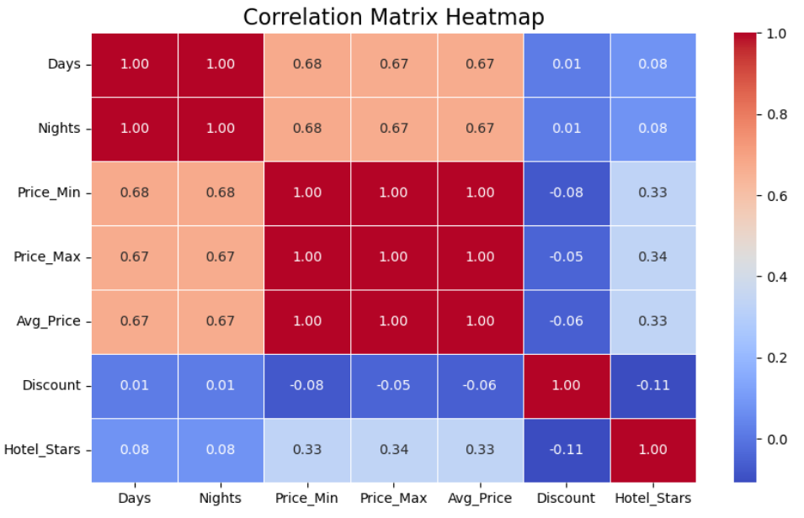
Correlation Matrix Heatmap :
This plot is a correlation matrix heatmap that visually summarizes the linear relationships between several numerical variables in the dataset. Correlation values range from -1 to 1, where 1 indicates perfect positive correlation, -1 indicates perfect negative correlation, and values near 0 indicate little or no correlation.
The heatmap shows strong internal correlations among time and price variables in the dataset, but minimal or negative association between discount rates and other features. Hotel star rating is weakly positively correlated with prices, but not related to discounts or duration of stay.

Slide 18

BUSINESS QUESTIONS AND INSIGHTS
Q1: Which destinations have the highest number of packages?
Insight: Popular destinations like Maldives, Bali, Dubai will likely have the most packages.
Q2: What is the price range distribution of tour packages?
Insight: Most packages fall under budget (₹10k–₹30k) and mid-range (₹30k–₹70k).
Q3: How do discounts vary across destinations?
Insight: Some destinations (like Maldives, Bali) might have higher discounts, showing high competition.
Q4: Which inclusions are most common in packages?
Insight: Sightseeing + Meals + Transfers are the most frequent.
Q5: Which destinations offer the best value (low price + good hotel rating + high discount)?
Insight: Certain mid-range destinations (e.g., Pattaya, Bali) may give 4-star hotels at budget prices with discounts.

Slide 19

Pricing Structure :
Packages have a wide range in prices (from ~7,999 to over 150,000).
The average price (Avg_Price) is strongly influenced by Price_Min and Price_Max, as expected.
Discount Trends :
Discounts vary significantly (from ~5% to 34%).
Higher discounts are often found in mid-range packages rather than luxury ones.
Duration of Packages :
Most packages range between 3–7 days.
Longer packages (10–13 days) are premium-priced (New Zealand, Cambodia-Vietnam, etc.).
Hotel StarsPackages :
cover a variety of accommodations, from 2-star to 5-star hotels.
Higher star ratings are generally correlated with higher prices.
Included Services :
Almost all packages highlight Sightseeing plus additional features (meals, transfers, adventure activities).
This indicates sightseeing is a baseline offering, with extras creating differentiation.

Slide 20

Pricing Strategy :
Highlight value-for-money mid-range packages (₹15,000–₹40,000), as they strike a balance between affordability and inclusions.
For premium packages (>₹1 lakh), emphasize luxury positioning and exclusive experiences.
Discount Optimization :
Instead of flat discounts, offer tiered discounts (e.g., early bird, festive offers) to drive conversions while protecting margins.
Product Segmentation :
Market short-duration packages (3–5 days) to working professionals and couples.
Promote long-duration packages (10+ days) to families and international travelers.
Marketing Communication:
Since sightseeing is common, focus on unique differentiators: adventure activities, cultural experiences, or family-friendly options.
Highlight “all-inclusive packages” to reduce customer decision friction.

Slide 21

Handling pagination and dynamic content loading (JavaScript), and inconsistent HTML structures, which lead to parsing and extraction failures.
Extracted data suffers from incomplete, inconsistence format, missing, data type conversions, and normalization.
Outlier handling in price,discount, and durations datasets was complex because bad or fake package listings can skew analysis.
Selecting the right plot types to represent insights.

Slide 22


Slide 23

THANK YOU

